Slide 1
University Registration System Project

Slide 2
Project Team
Name :- Abdalla Gaber Ashour ID :- 20221460120
Name :- Ali Amr Ali ID :- 20221460130

Slide 3
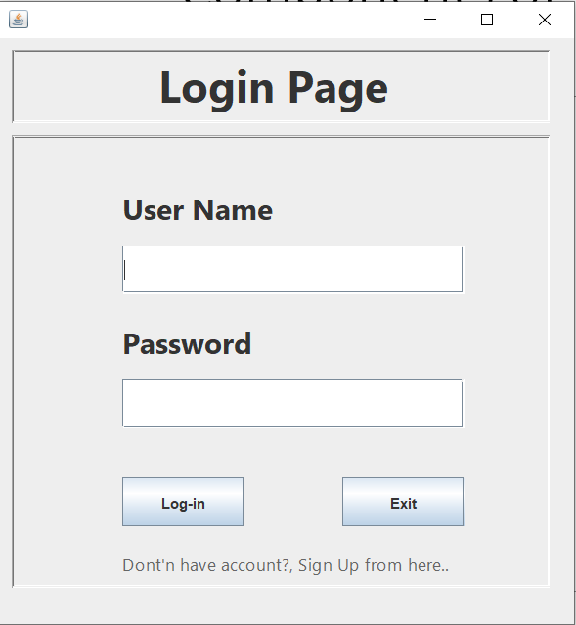
Components of project
Login Page
Registration Page
Console Panel

Slide 4
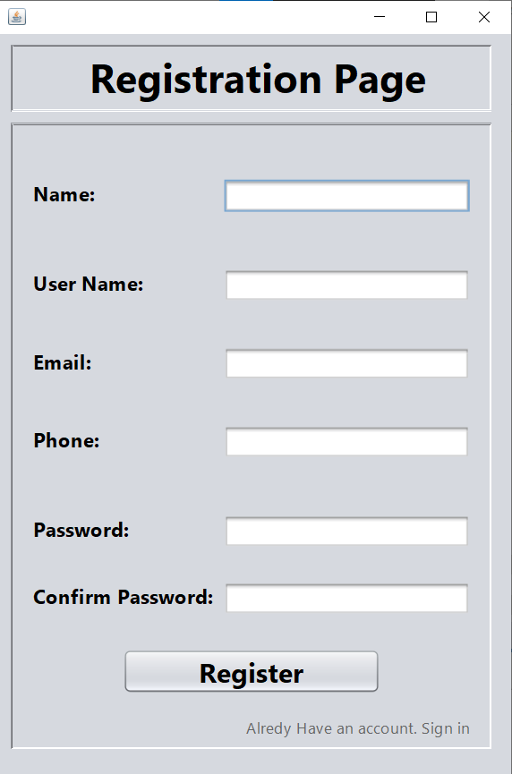
Registration Page

Slide 5
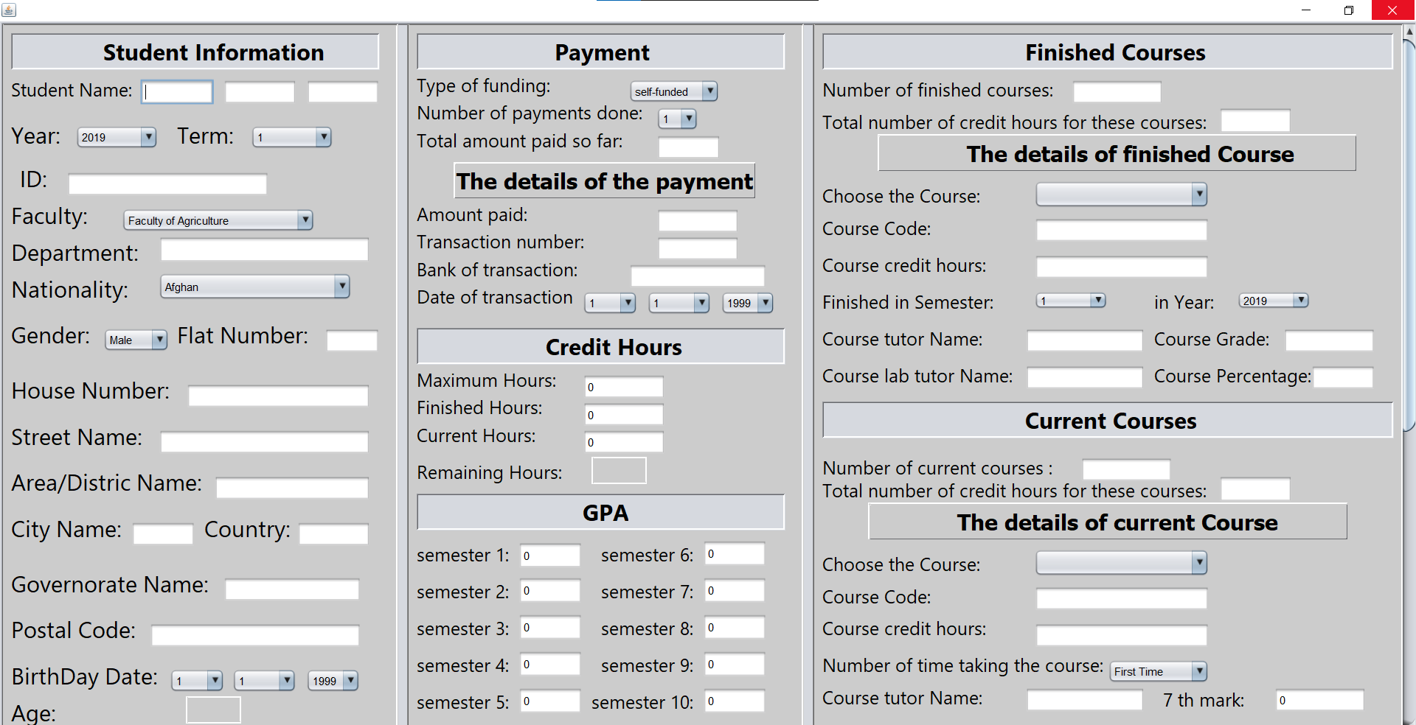
Console Panel

Slide 6
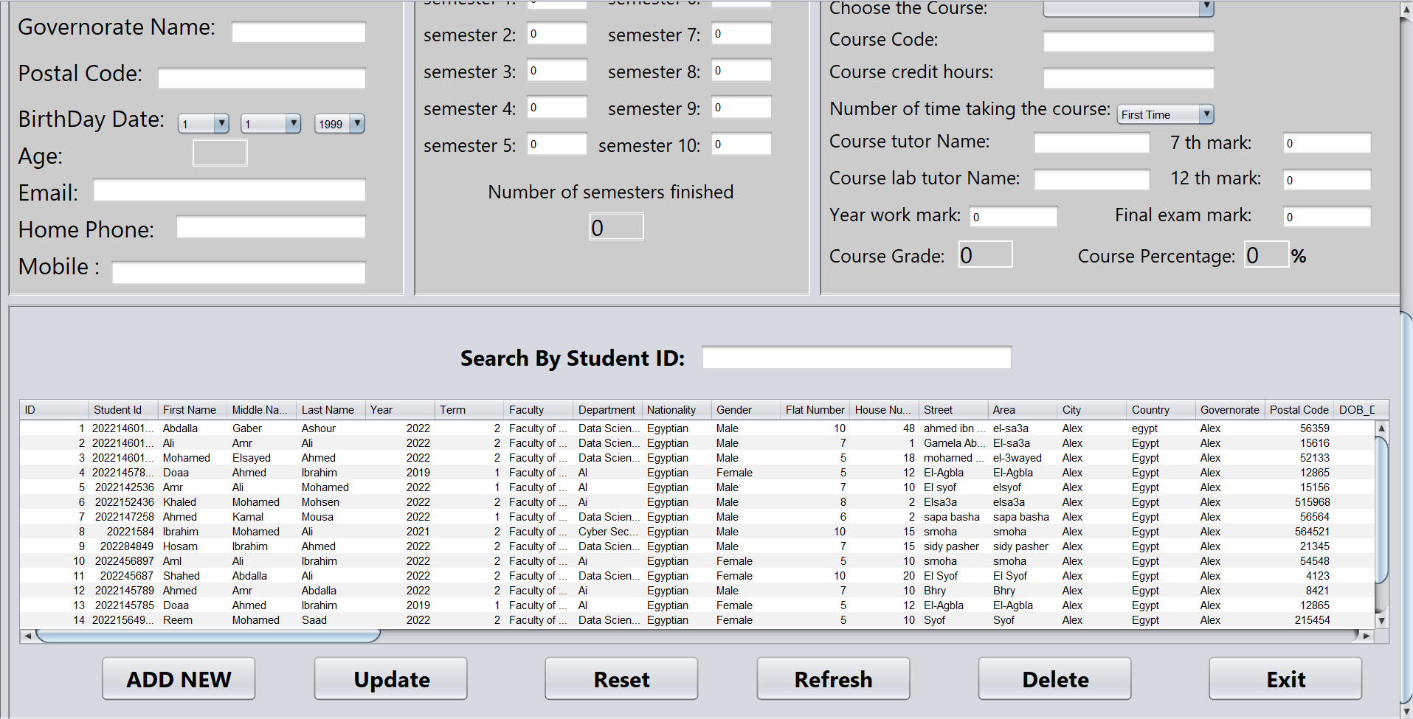
Console Panel

Slide 7
Buttons

Slide 8
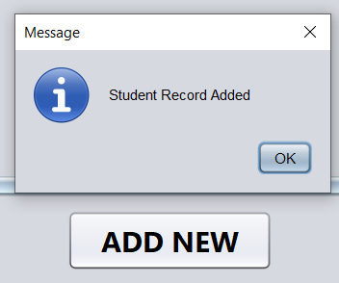
ADD NEW (Button)
To add record to database by user
If the user add every thing correct the system show that the student record added successfully

Slide 9
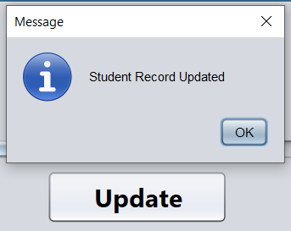
Update (Button)
To update record in database
After the user modify the student record and pressed on the button the message appear that student record updated successfully

Slide 10
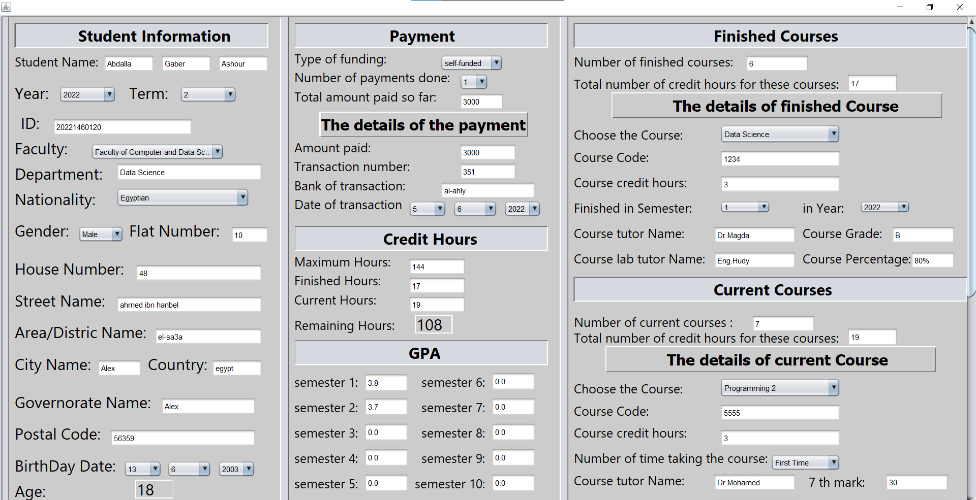
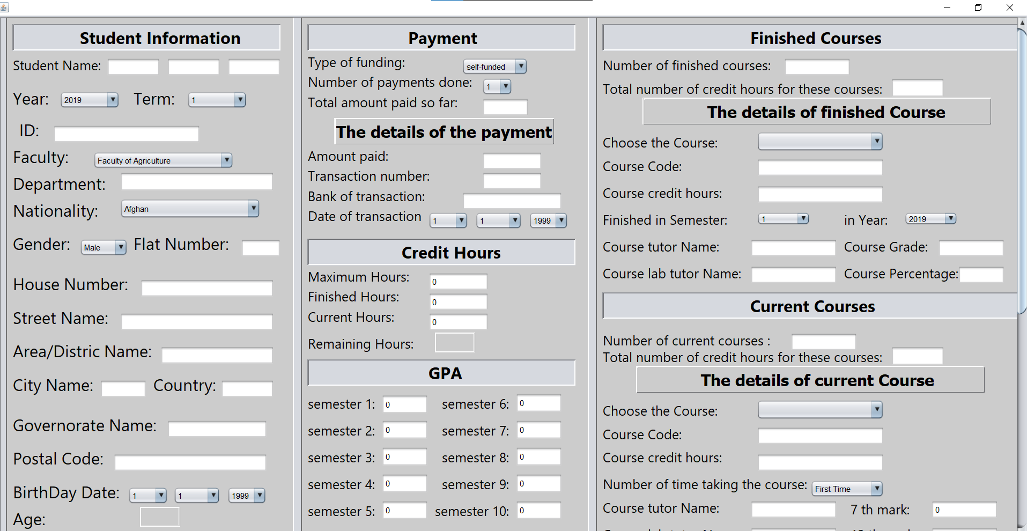
Reset (Button)
Before Reset
After Reset

Slide 11
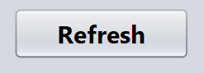
Refresh (Button)
To refresh the database table to see the new updated database if other user modify it

Slide 12
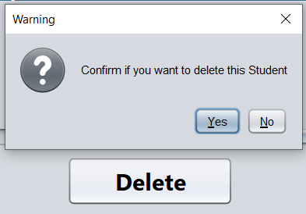
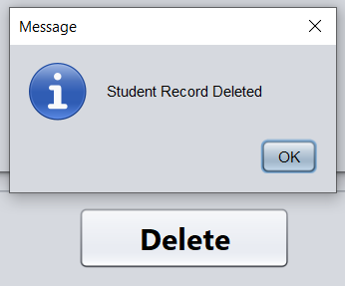
Delete (Button)
To delete record in database
After the user press delete button the warning message appear to confirm if he really want to delete student record
When the user press “yes” the message appear that student record deleted successfully

Slide 13
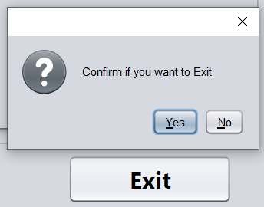
Exit (Button)
To close the program
After the user press exit button the warning message appear to confirm if he really want to close the program
When the user press “yes” the program automatically close

Slide 14

Automatic Actions

Slide 15
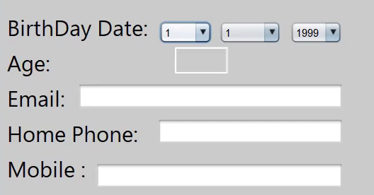
Age Calculator

Slide 16
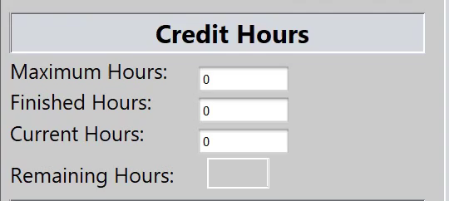
Remaining Credit Hours Calculator

Slide 17
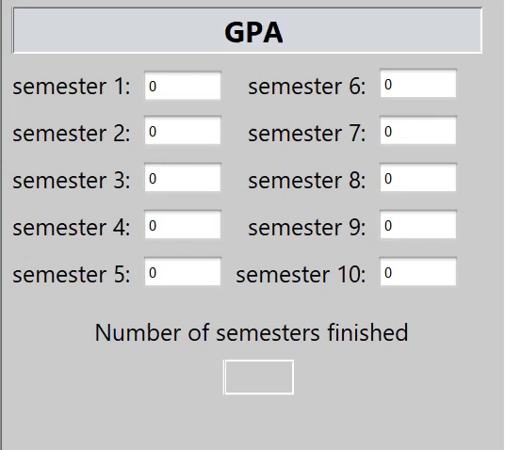
Number Of Semesters Finished Calculator

Slide 18
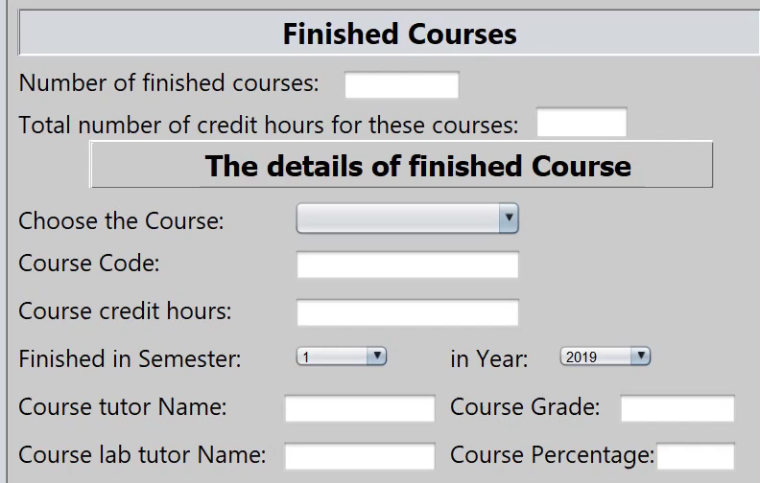
Finished Course Information Autofill

Slide 19
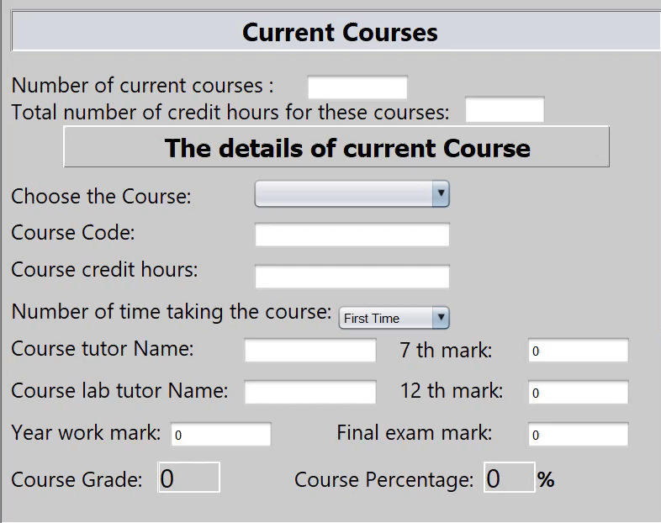
Current Course Information Autofill

Slide 20

Course Grade & Percentage Calculator

Slide 21
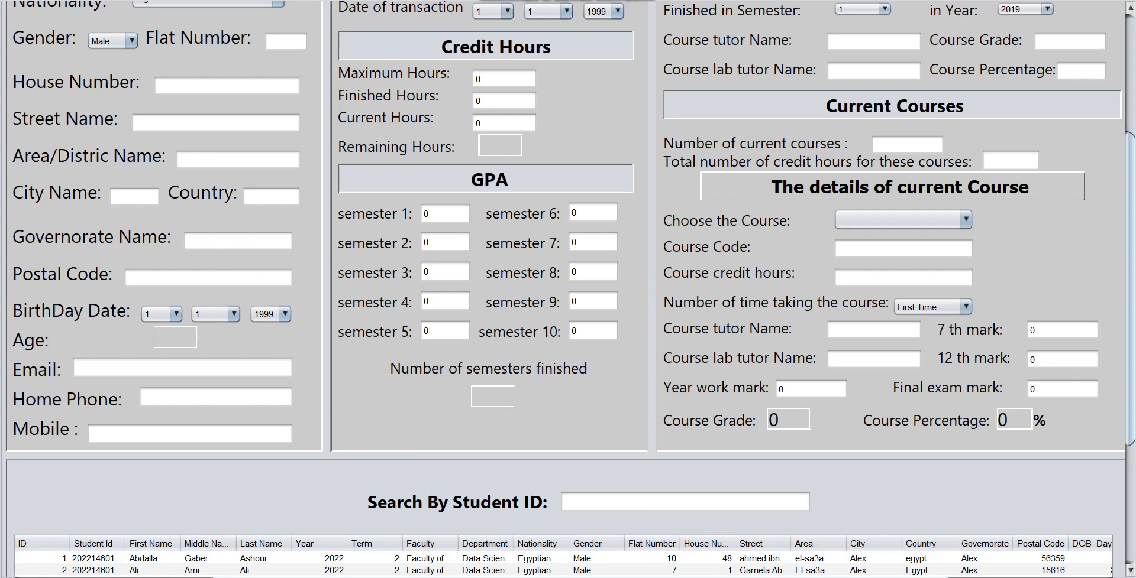
Show Student Information from Database

Slide 22
Thanks

